Slide 1


Maximizing Efficiency in Geotechnical Monitoring
A Cost Study on the Inzwa Veva III + Inzwa Cloud

Slide 2

Summary of Findings
Solution Overview
The Veva III is a rugged, wireless vibration, noise, and tilt monitoring device that pairs with Inzwa Cloud for centralized monitoring and automated reporting.
Strategic Value
Faster deployment, less service calls, reduced analysis time, and stronger compliance support for project managers and engineers.
Key Finding
An Inzwa geotechnical monitoring solution can achieve up to 38% total savings versus typical multi-box sensor setups and manual reporting workflows.
Notes:
The platform is device agnostic- that means it’s able to bring all your sensor data together in one place to make it easy to see all your project’s site data in one place.
The platform automatically knows how to handle sensor data. With our prebuilt dashboards like what you’re seeing here, it requires very little configuration to get the data visualizations you need.
We make project-level reporting easy with a report-template builder that can be easily saved, replicated and customized, reducing what used to take hours to minutes per week.
The platform is flexible and can scale from one-sensor projects up to thousands.

Slide 3
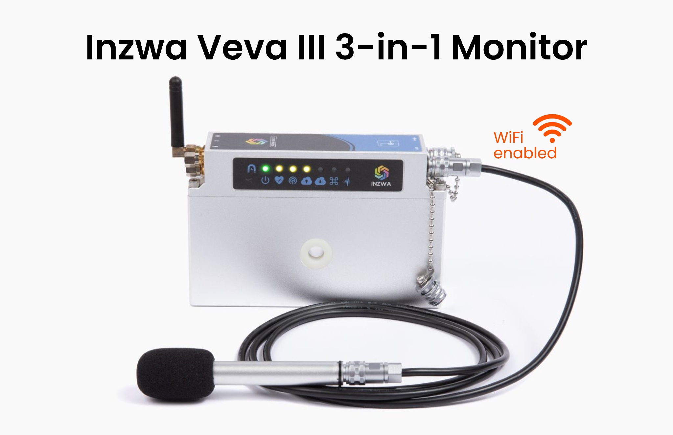
Product Overview: Veva III Device
Key Features
Measures vibration, noise, and tilt in a single device.
Integrated solar, battery, and 4G modem; Wi‑Fi enabled for flexible connectivity.
Long battery life (up to ~6 months) and rugged, field-ready design.
Simple setup and minimal maintenance reduce time on site.
Notes:
The platform is device agnostic- that means it’s able to bring all your sensor data together in one place to make it easy to see all your project’s site data in one place.
The platform automatically knows how to handle sensor data. With our prebuilt dashboards like what you’re seeing here, it requires very little configuration to get the data visualizations you need.
We make project-level reporting easy with a report-template builder that can be easily saved, replicated and customized, reducing what used to take hours to minutes per week.
The platform is flexible and can scale from one-sensor projects up to thousands.

Slide 4
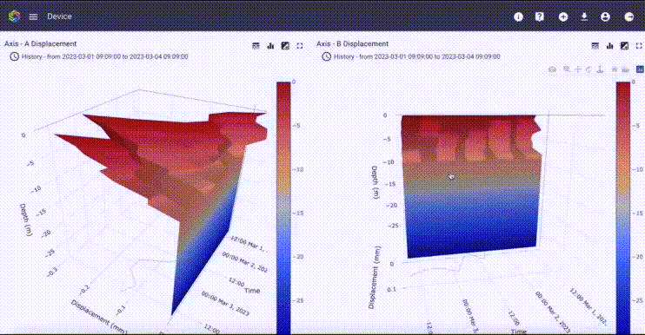
Product Overview: Inzwa Cloud
Key Features
Centralizes all site sensor data in one place across devices and vendors.
Pre-built dashboards require little configuration to visualize data quickly.
Project-level reporting and automated alerts streamline compliance workflows.
GIS integrations and scalable architecture support multi-site deployments.
Notes:
The platform is device agnostic- that means it’s able to bring all your sensor data together in one place to make it easy to see all your project’s site data in one place.
The platform automatically knows how to handle sensor data. With our prebuilt dashboards like what you’re seeing here, it requires very little configuration to get the data visualizations you need.
We make project-level reporting easy with a report-template builder that can be easily saved, replicated and customized, reducing what used to take hours to minutes per week.
The platform is flexible and can scale from one-sensor projects up to thousands.

Slide 5
Total Cost of Operations (TCO)
Sound and Vibration Monitoring Scenario
Devices: One vibration monitoring device and one Class 1 mic for sound monitoring.
Deployment Term: Five, six-month projects over three years; for a total of 30 months of deployment.
Labor Costs: $40/hour for setup, servicing and reporting work.
Notes:
The platform is device agnostic- that means it’s able to bring all your sensor data together in one place to make it easy to see all your project’s site data in one place.
The platform automatically knows how to handle sensor data. With our prebuilt dashboards like what you’re seeing here, it requires very little configuration to get the data visualizations you need.
We make project-level reporting easy with a report-template builder that can be easily saved, replicated and customized, reducing what used to take hours to minutes per week.
The platform is flexible and can scale from one-sensor projects up to thousands.

Slide 6

Comparison: Hardware Cost
Items Included: Vibration Monitor, Sound Level Monitor, and Battery
$15,000
Inzwa Costs: $7,000
Competitor Costs: $11,800
Inzwa Savings: $4,800
Inzwa % Savings: 40.7%
$12,000
Save up
to 41%
$9,000
Mems Based Competitor
$6,000
$3,000
Inzwa Veva III
$0
Notes:
The platform is device agnostic- that means it’s able to bring all your sensor data together in one place to make it easy to see all your project’s site data in one place.
The platform automatically knows how to handle sensor data. With our prebuilt dashboards like what you’re seeing here, it requires very little configuration to get the data visualizations you need.
We make project-level reporting easy with a report-template builder that can be easily saved, replicated and customized, reducing what used to take hours to minutes per week.
The platform is flexible and can scale from one-sensor projects up to thousands.

Slide 7
Comparison: Project Recurring Costs
Items Included: Replacement Batteries, Installation, Calibration, Servicing, Provisioning, and Weekly Report Preparation
$5,000
Inzwa Costs: $2,300
Competitor Costs: $4,030
Inzwa Savings: $1,740
Inzwa % Savings: 57%
$4,000
Save up
to 57%
$3,000
Mems Based Competitor
Mems Based Competitor
$2,000
$1,000
Inzwa Veva III
Inzwa Veva III
$0
Notes:
The platform is device agnostic- that means it’s able to bring all your sensor data together in one place to make it easy to see all your project’s site data in one place.
The platform automatically knows how to handle sensor data. With our prebuilt dashboards like what you’re seeing here, it requires very little configuration to get the data visualizations you need.
We make project-level reporting easy with a report-template builder that can be easily saved, replicated and customized, reducing what used to take hours to minutes per week.
The platform is flexible and can scale from one-sensor projects up to thousands.

Slide 8
Comparison: Annual Recurring Costs
Items Included: Calibration and Data Platform Access
$2,500
Save up
to 11%
Inzwa Costs: $2,100
Competitor Costs: $2,350
Inzwa Savings: $250
Inzwa % Savings: 10.6%
$2,000
$1,500
Mems Based Competitor
Mems Based Competitor
$1,000
$500
Inzwa Veva III
Inzwa Veva III
$0
Notes:
The platform is device agnostic- that means it’s able to bring all your sensor data together in one place to make it easy to see all your project’s site data in one place.
The platform automatically knows how to handle sensor data. With our prebuilt dashboards like what you’re seeing here, it requires very little configuration to get the data visualizations you need.
We make project-level reporting easy with a report-template builder that can be easily saved, replicated and customized, reducing what used to take hours to minutes per week.
The platform is flexible and can scale from one-sensor projects up to thousands.

Slide 9
Comparison: Total Cost of Operations
Items Included: Hardware Costs, Project Recurring Costs, and Annual Recurring Costs
$20,000
Inzwa Costs: $11,500
Competitor Costs: $18,450
Inzwa Savings: $6,950
Inzwa % Savings: 37.7%
$16,000
Save up
to 38%
$12,000
Mems Based Competitor
Mems Based Competitor
$8,000
$4,000
Inzwa Veva III
Inzwa Veva III
$0
Notes:
The platform is device agnostic- that means it’s able to bring all your sensor data together in one place to make it easy to see all your project’s site data in one place.
The platform automatically knows how to handle sensor data. With our prebuilt dashboards like what you’re seeing here, it requires very little configuration to get the data visualizations you need.
We make project-level reporting easy with a report-template builder that can be easily saved, replicated and customized, reducing what used to take hours to minutes per week.
The platform is flexible and can scale from one-sensor projects up to thousands.

Slide 10
Strategic Benefits Beyond Cost
Inzwa Solution Benefits
Ease of Deployment: one technician can install and manage multiple units.
Reliability: long-lasting power and rugged design for harsh job sites.
Scalability: rapidly deploy across multiple projects and locations.
Compliance: automated reporting supports regulatory adherence and audit trails.
Notes:
The platform is device agnostic- that means it’s able to bring all your sensor data together in one place to make it easy to see all your project’s site data in one place.
The platform automatically knows how to handle sensor data. With our prebuilt dashboards like what you’re seeing here, it requires very little configuration to get the data visualizations you need.
We make project-level reporting easy with a report-template builder that can be easily saved, replicated and customized, reducing what used to take hours to minutes per week.
The platform is flexible and can scale from one-sensor projects up to thousands.

Slide 11


What Customers Are Saying...
Joel Kurtz, DRW Associates
"With Inzwa, I was able to program everything in the Cloud platform before I left for the site. Once there, all I had to do was drill a hole, bolt it to the wall, turn it on and confirm it was connected from my tablet. That was it.”
Kyle Scanlon, KUE
"It’s really easy to install and set up, it provides long-lasting battery life, especially for these projects that go on for multiple months. Inzwa’s done a great job designing a product that can be unboxed and set up in minutes."
Notes:
Bullets build on click

Slide 12
Conclusion
The Inzwa Veva III, which combines vibration, noise, and tilt in one rugged device, paired with Inzwa Cloud, simplifies monitoring and reporting in geotechnical projects. Teams deploy faster, visit sites less, and spend less time on configuration and analysis. As demonstrated in this TCO analysis, an Inzwa monitoring and reporting solution delivers up to 38% savings over three years.
Notes:
The platform is device agnostic- that means it’s able to bring all your sensor data together in one place to make it easy to see all your project’s site data in one place.
The platform automatically knows how to handle sensor data. With our prebuilt dashboards like what you’re seeing here, it requires very little configuration to get the data visualizations you need.
We make project-level reporting easy with a report-template builder that can be easily saved, replicated and customized, reducing what used to take hours to minutes per week.
The platform is flexible and can scale from one-sensor projects up to thousands.

Slide 13


Ready for monitoring with more efficiency and less headaches?
Request a Quote Now

